Slide 1



Intelligent searches with Azure Cognitive Search
Marco Minerva
Microsoft MVP Windows Development
Intel Software Innovator
https://about.me/marcominerva
Riccardo Cappello
Microsoft MVP Microsoft Azure
Intel Software Innovator
https://about.me/rcappello

Slide 2










A BIG thank you to the 2019 Global Sponsors!

Slide 3
Azure AI
AI apps & agents
Machine learning
Knowledge mining
Azure Bot Service
Azure Cognitive Services
Azure Databricks
Azure Machine Learning
Azure AI infrastructure
Azure Cognitive Search

Slide 4

Knowledge Mining is the process of discovering actionable information from large sets of unstructured data, like text or images. It uses Artificial Intelligence to detect hidden patterns and information. It can be used to guarantee compliance, enrich search, automate processes, among other business processes.
Notes:
Elevator Pitch

Slide 5
Cognitive Search is the Microsoft solution for Knowledge Mining. AI approach for content understanding. Ingests unstructured content to create rich metadata into an Azure Search index, with the power of Cognitive Services.
Notes:
At the end of the day…

Slide 6
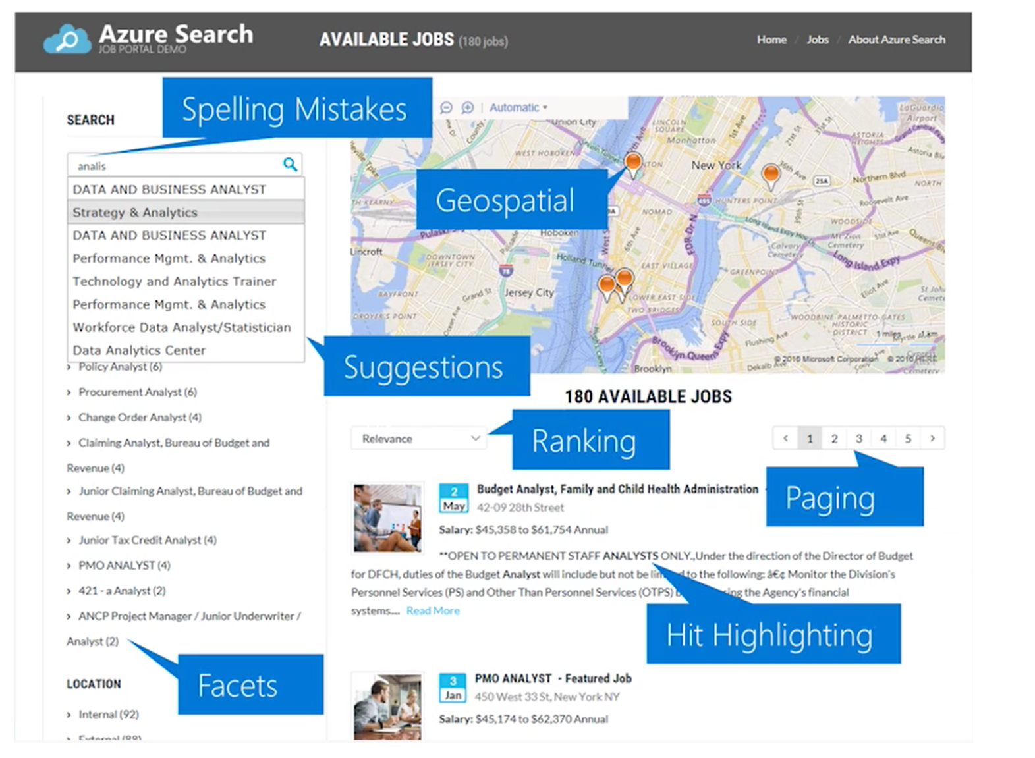
What Azure Search is
AI-Powered cloud search service for web and mobile app development
Enterprise Search as a Service – Azure PaaS product
Enrich and extract insights through cognitive skills (Cognitive Search)
Easily scale up and down
Natural Language Processing for web search grade experience
Connect search results to business goals with great control over search ranking
99.9% SLA, GDPR, Standard Azure OST (Online Service Terms)
Creates indexed metadata about your data

Slide 7
What Cognitive Search is
Azure Search feature, Announced in May 2018 (MS Build)
It uses AI to create searchable metadata, transforming unstructured data into information
Data Enrichment =! Data Integration. Original data isn’t moved, changed or copied
Results are always loaded into an Azure Search Index
10+ regions, including South Central US, West Europe, North Europe, Brazil South, and Southeast Asia
Azure Search Cost + Cost per image + Cost per Cognitive Service used
OR Azure Search Cost + Free up to 20 documents per day

Slide 8






Azure Cognitive Search Pipeline
Data
Source
Enriched
Documents
Ingest Enrich Explore
Any Data format
Any Azure Store
Cognitive Skills
Azure Search API
Portal
Notes:
Azure Search feature, Announced in May 2018 (MS Build)
It uses AI to create searchable metadata, transforming unstructured data into information
Data Enrichment =! Data Integration. Original data isn’t moved, changed or copied
Results are always loaded into an Azure Search Index
10+ regions, including South Central US, West Europe, North Europe, Brazil South, and Southeast Asia
Azure Search Cost + Cost per image + Cost per Cognitive Service used
OR Azure Search Cost + Free up to 20 documents per day

Slide 9
Demo

Slide 10
Demos – Cognitive Search
Enrichment Pipeline
https://text-analytics-demo-dev.azurewebsites.net/
JFK Files
https://jfk-demo.azurewebsites.net/
Business Documents Demo - Wolters Kluwer
https://wolterskluwereap.azurewebsites.net/
Oil & Gas Demo - Exxon Mobile
http://seismicsearch.azurewebsites.net/
Healthcare - CTakes
http://webmedsearch.azurewebsites.net/
Notes:
JFK – Search for Lee, KGB, Microsoft, Martin Luther King . Open Source data.
Wolters Kluwer – search for Microsoft, Risk + Fraud example in the landing page.
Exxon - It relates to seismic in the Oil and Gas domain. Open Source data. Try Kundsen or Chirp as search terms.
CTakes - pick any disease that you want and walk through a Cognitive Search implementation using custom skills based on Ctakes (an opensource software for medical extraction)
Cognitive Services – just use the suggested text

Slide 11
Additional Resources
http://aka.ms/LearnAI-kmb
http://aka.ms/LearnAI-links
https://github.com/DotNetToscana/CognitiveSearch
https://docs.microsoft.com/azure/search/cognitive-search-concept-intro
https://docs.microsoft.com/azure/search/cognitive-search-quickstart-blob
https://docs.microsoft.com/azure/search/cognitive-search-create-custom-skill-example

Slide 12
Thanks!
Marco Minerva
Microsoft MVP Windows Development
Intel Software Innovator
https://about.me/marcominerva
Riccardo Cappello
Microsoft MVP Microsoft Azure
Intel Software Innovator
https://about.me/rcappello

Slide 13
Day's Schedule
Time | Activity / Session Title | Speaker
9:00 – 9:30 | Guest arrival, Registration | Staff
9:30 – 10:00 | Keynote | Marco Dal Pino
10:00 – 10:50 | Usare Azure IaaS in modo serio. Casi d'uso reali. | Francesco Valerio Buccoli
10:50 – 11:05 | Break
11:05 – 11:55 | Azure Pipelines for Githubbers | Massimo Bonanni
11:55 – 12:45 | Ricerche intelligenti con Cognitive Search | Marco Minerva – Riccardo Cappello
12:45 – 14:15 | Lunch & Session: Introduction to .NET Core Microservices Development with AzureDevSpaces | Giancarlo Lelli
14:15 – 15:05 | Industrial IoT: Dalle parole ai fatti | Riccardo Zamana
15:05 – 15:20 | Break
15:20 – 16:10 | Azure PaaS Databases | Gianluca Hotz
16:10 – 17:00 | Automate deeply with the power of PaaS | Roberto Freato
17:00 – 17:30 | Closing Remarks, Questions, Raffle & Guest Departure | Staff

